Slide 1
ECE411 MP4 Presentation
Group: Pikachu
Member: Tingkai Liu, Zhi Cen
Notes:
Hi everyone. My name is LTK and my teammate is CZ. We are a two-people group.

Slide 2
Advanced features and evaluations
 | Comp1 | Comp2 | Comp3
Order | 44437 | 87863 | 47243
Data memory access | 2813 | 4399 | 11134
Runtime (ns) | 495055 (1.5x speedup) | 1308735 (3.5x speedup) | 926585 (4x speedup)
Power (mW) | 830.57 | 831.56 | 772.76
I-Cache L1 miss | 57/44437 = 0.12% | 6524/87863 = 7.5% | 6246/47243 = 13%
I-Cache L2 miss | 27/57 = 47% | 171/6524 = 2.6% | 130/6246 = 2.1%
D-Cache L1 miss | 14/2813 = 0.50% | 82/4399 = 1.9% | 567/11134 = 5.1%
D-Cache L2 miss | 7/14 = 50% | 27/82 = 33% | 283/567 = 50%
Branch prediction accuracy | 10683/12370=86% | 27506/34620 = 79% | 3665/4391 = 83%
Advanced features:
L1 2-way cache + L2 4-way cache
Basic hardware prefetch
Global 2-level branch predictor
Notes:
Fmax: 104.67 MHz.
Speed up = $\frac{Latency}{BaselineLatency}$.
Notes:
For advance features, we implemented L2 cache, 4 way caches, prefetching, and a branch predictor. We will talk more about them later, but let’s focus on their performance first. For comp1 code, since the memory access pattern is not that complicated, the L1 cache miss rate is low and the speedup mainly comes from branch prediction. For comp2 and comp3 code, L2 cache has helped a lot, as they access more than 2 cache lines memory frequently. One of the surprising discoveries is the miss rate of L1 I cache is pretty high. I think that’s because there are long loops in a code that the code goes cross several cache lines repeatedly. In this case, the L2 I Cache increases the performance quite a lot.

Slide 3
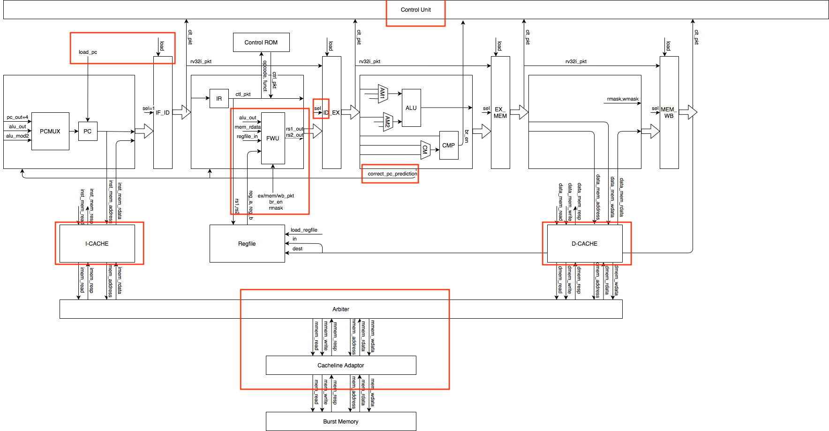
Cache: Why L2 cache matters?
4-way L1 cache creates long critical path.
Use 2-way L1 cache and L2 cache.
It takes a long time to read from or write to burst memory.
Reduce the LLC miss by using 4-way L2 cache.
590ns
590ns

Slide 4
L1 I-cache with basic hardware prefetch
Basic hardware prefetch is to
prefetch line_(i+1) when line_i is a hit and line_(i+1) is a miss.
Therefore, it works well when memory is sequentially accessed.
Most of the instructions are sequentially accessed.

Slide 5
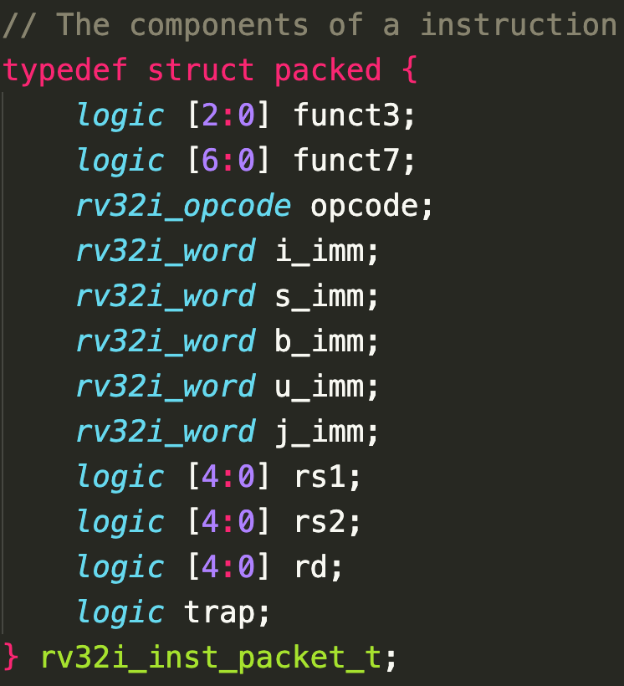
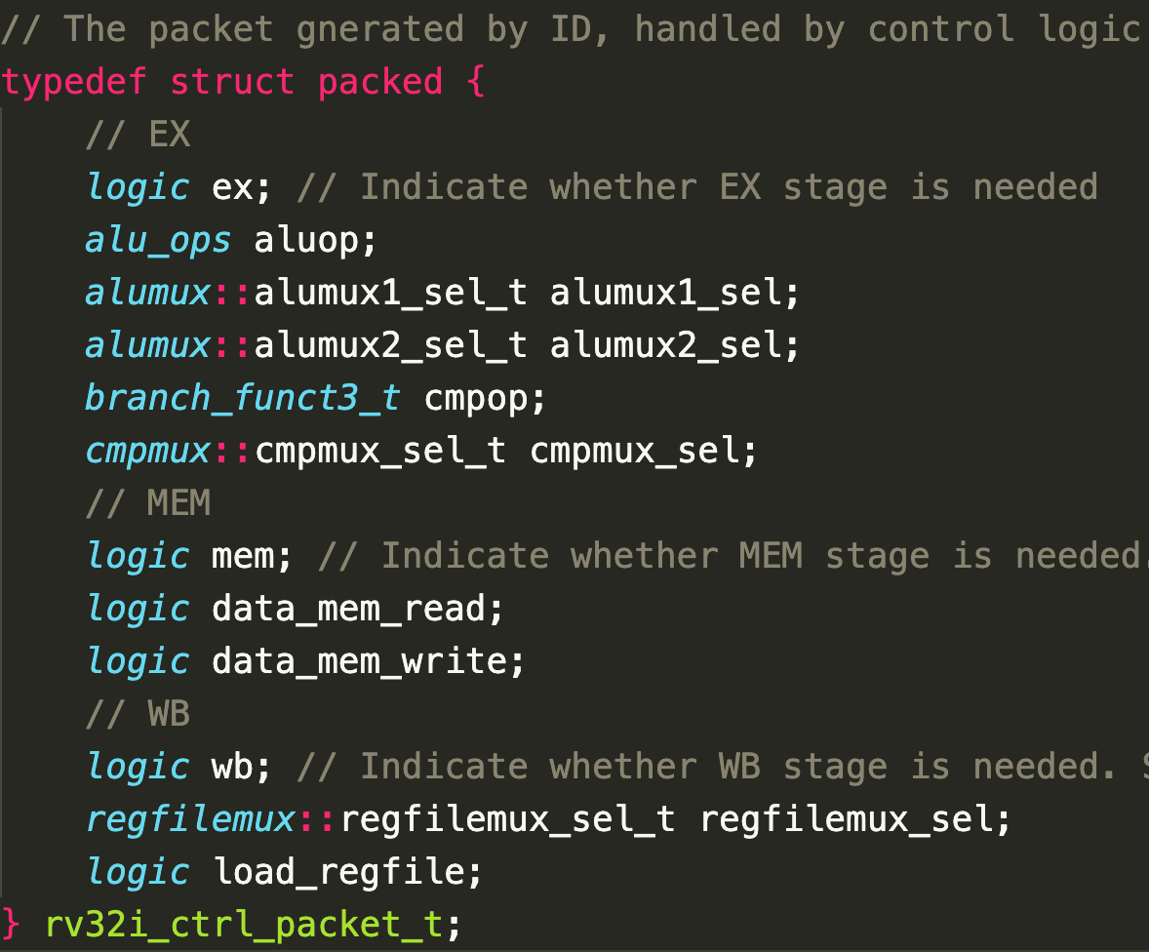
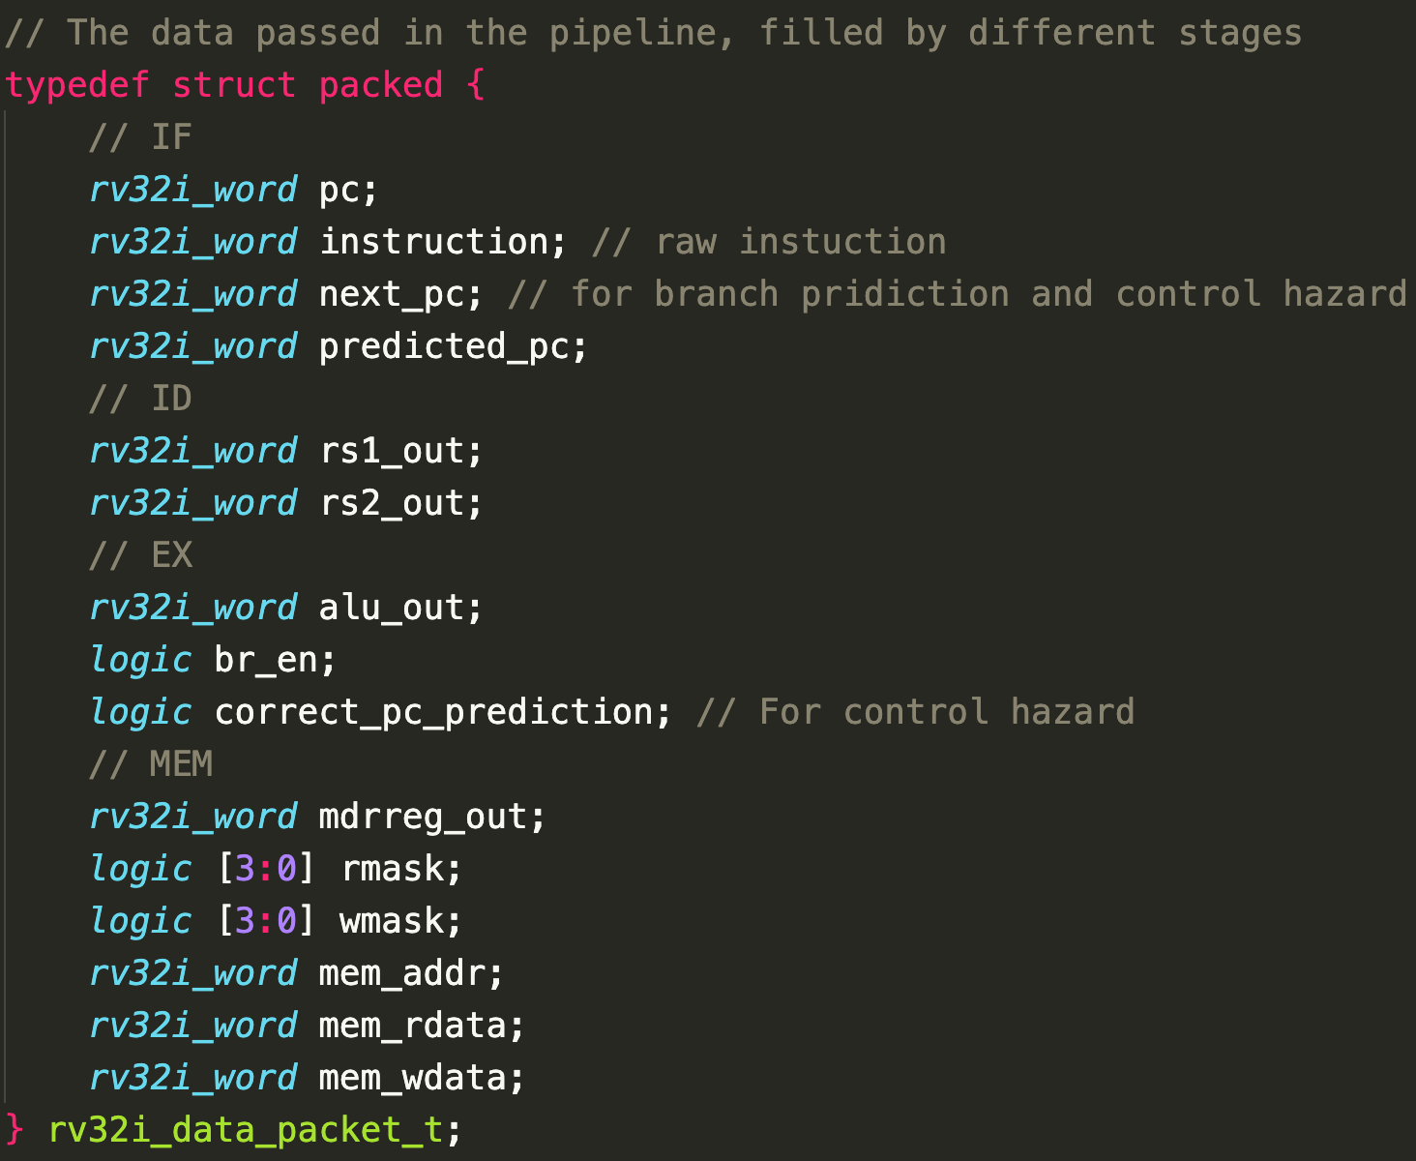
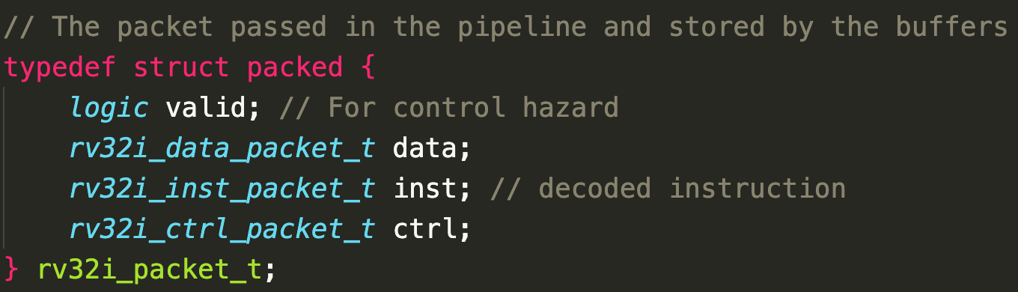
Highlight on Basic design
Notes:
In terms special thing in our basic design. Instead of having complicated interconnection between different components, we classified the components into different stages and use the “packet” structure for their communication, as shown in the picture like this, this, and this.
In this way, every stages in the pipeline have a global view on the whole execution of the instruction. The components in each stage can just get the data it need from the packet and fill its output to the packet, and then pass the whole packet to the next stage. This simplifies our design and debug process a lot, especially on data forwarding, and adds more flexibility when we are trying to add new components.

Slide 6
More Possibilities
If we have more time: Out of Order Execution
Power
Notes:
In terms of what we wish to do, there are mainly two parts. The first one is to implement the out of order execution. We started to think about this at cp1, that is also a reason why we used “packet” between stages. It would be very convenient if we broadcast the whole packet on common data bus. However, due to time limitation and the difficulty to implement dynamic register dependency in hardware, we didn’t mange it.
Another possibility is the advance features of power. In lecture we talked about powers a lot, and it is indeed a real challenge. I was surprised that in the advance feature list power is not mentioned at all. I think we can at least implement the clock gating and use the simulation of Quartus to evaluate the performance. Of course, there will be additional complexity on understanding what is going on with the power simulation, but I do suggest putting it into the list for future students.

Slide 7
Thank you!

